Slide 1
Topic 9
More Graphics
Based on slides bu Marty Stepp and Stuart Reges _x000b_from http://www.buildingjavaprograms.com/

Slide 2
Clicker Question
What happens if a graphics object is used to draw a shape that exceeds the boundaries of the DrawingPanel?
DrawingPanel p3 = new DrawingPanel(100, 100);
Graphics g2 = p3.getGraphics();
g2.fillRect(50, 50, 200, 200);
Only the visible portion shown
B. DrawingPanel expands to show whole rectangle
C. Syntax error
D. Runtime error
E. None of A - D are correct

Slide 3
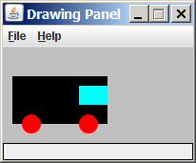
Animation exercise
Modify the following program to draw a "moving" car.
import java.awt.*;
public class Car {
public static void main(String[] args) {
DrawingPanel panel = new DrawingPanel(200, 100);
panel.setBackground(Color.LIGHT_GRAY);
Graphics g = panel.getGraphics();
g.setColor(Color.BLACK);
g.fillRect(10, 30, 100, 50);
g.setColor(Color.RED);
g.fillOval(20, 70, 20, 20);
g.fillOval(80, 70, 20, 20);
g.setColor(Color.CYAN);
g.fillRect(80, 40, 30, 20);
}
}

Slide 4
Parameterized Drawing
drawTruck0 -> hard coded location and size
drawTruck1 -> parameterized location, hard coded size
drawTruck2 -> parameterized location and size
animate the truck using the sleep method from drawing panel

Slide 5
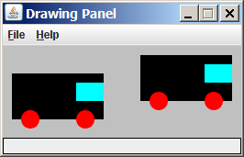
Parameterized figures
Modify the car-drawing method so that it can draw cars at different positions, as in the following image.
  Top-left corners: (10, 30), (150, 10)
  Increase the drawing panel's size to 260x100 to fit.

Slide 6
Drawing with parameters
To draw in a method, you must pass Graphics g to it.
  Otherwise, g is out of scope and cannot be used.
syntax (declaration):
  public static void <name> (Graphics g, <parameters>) {
  <statement(s)> ;
  }
syntax (call):
  <name> (g, <values>);

Slide 7
Parameterized answer
import java.awt.*;
public class Car3 {
public static void main(String[] args) {
DrawingPanel panel = new DrawingPanel(260, 100);
panel.setBackground(Color.LIGHT_GRAY);
Graphics g = panel.getGraphics();
drawCar(g, 10, 30);
drawCar(g, 150, 10);
}
public static void drawCar(Graphics g, int x, int y) {
g.setColor(Color.BLACK);
g.fillRect(x, y, 100, 50);
g.setColor(Color.RED);
g.fillOval(x + 10, y + 40, 20, 20);
g.fillOval(x + 70, y + 40, 20, 20);
g.setColor(Color.CYAN);
g.fillRect(x + 70, y + 10, 30, 20);
}
}

Slide 8
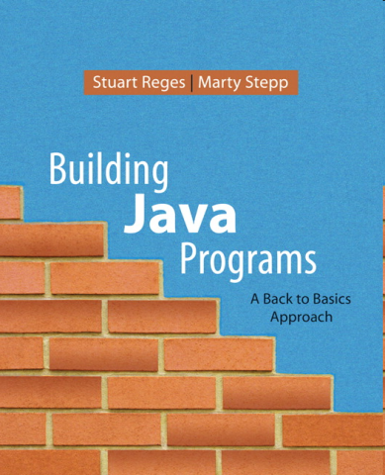
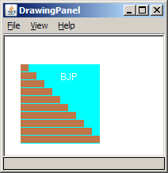
Java book figure
Write a program that draws the following figure:
  drawing panel is size 200x150
  book is at (20, 35), size 100x100
  cyan background
  white "BJP" text at position (70, 55)
  stairs are (red=191, green=118, blue=73)
  each stair is 9px tall
    1st stair is 10px wide
    2nd stair is 20px wide ...
  stairs are 10px apart (1 blank pixel between)

Slide 9
Java book solution
// Draws a Building Java Programs textbook with DrawingPanel.
import java.awt.*;
public class Book {
public static void main(String[] args) {
DrawingPanel panel = new DrawingPanel(200, 150);
panel.setBackground(Color.WHITE);
Graphics g = panel.getGraphics();
g.setColor(Color.CYAN); // cyan background
g.fillRect(20, 35, 100, 100);
g.setColor(Color.WHITE); // white "bjp" text
g.drawString("BJP", 70, 55);
g.setColor(new Color(191, 118, 73));
for (int i = 0; i < 10; i++) { // orange "bricks"
g.fillRect(20, 35 + 10 * i, 10 + 10 * i, 9);
}
}
}

Slide 10
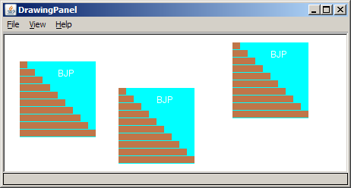
Multiple Java books
Modify the Java book program so that it can draw books at different positions as shown below.
  book top/left positions: (20, 35), (150, 70),
  (300, 10)
  drawing panel's new size: 450x180

Slide 11
Multiple books solution
// Draws many BJP textbooks using parameters.
import java.awt.*;
public class Book2 {
public static void main(String[] args) {
DrawingPanel panel = new DrawingPanel(450, 180);
panel.setBackground(Color.WHITE);
Graphics g = panel.getGraphics();
// draw three books at different locations
drawBook(g, 20, 35);
drawBook(g, 150, 70);
drawBook(g, 300, 10);
}
...

Slide 12
Multiple books, cont'd.
...
// Draws a BJP textbook at the given x/y position.
public static void drawBook(Graphics g, int x, int y) {
g.setColor(Color.CYAN); // cyan background
g.fillRect(x, y, 100, 100);
g.setColor(Color.WHITE); // white "bjp" text
g.drawString("BJP", x + 50, y + 20);
g.setColor(new Color(191, 118, 73));
for (int i = 0; i < 10; i++) { // orange "bricks"
g.fillRect(x, y + 10 * i, 10 * (i + 1), 9);
}
}
}

Slide 13
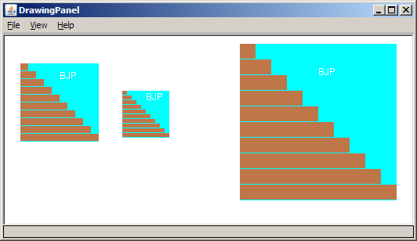
Resizable Java books
Modify the Java book program so that it can draw books at different sizes as shown below.
  book sizes: 100x100, 60x60, 200x200
  drawing panel's new size: 520x240

Slide 14
Resizable books solution
// Draws many sized BJP textbooks using parameters.
import java.awt.*;
public class Book3 {
public static void main(String[] args) {
DrawingPanel panel = new DrawingPanel(520, 240);
panel.setBackground(Color.WHITE);
Graphics g = panel.getGraphics();
// draw three books at different locations/sizes
drawBook(g, 20, 35, 100);
drawBook(g, 150, 70, 60);
drawBook(g, 300, 10, 200);
}
...

Slide 15
Resizable solution, cont'd.
...
// Draws a book of the given size at the given position.
public static void drawBook(Graphics g, int x, int y, int size) {
g.setColor(Color.CYAN); // cyan background
g.fillRect(x, y, size, size);
g.setColor(Color.WHITE); // white "bjp" text
g.drawString("BJP", x + size/2, y + size/5);
g.setColor(new Color(191, 118, 73));
for (int i = 0; i < 10; i++) { // orange "bricks"
g.fillRect(x, // x
y + size/10 * i, // y
size/10 * (i + 1), // width
size/10 - 1); // height
}
}
}

Slide 16
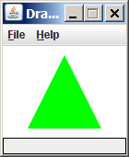
Polygon
Objects that represent arbitrary shapes
Add points to a Polygon using its addPoint(x, y) method.
Example:
  DrawingPanel p = new DrawingPanel(100, 100);
  Graphics g = p.getGraphics();
  g.setColor(Color.GREEN);
  Polygon poly = new Polygon();
  poly.addPoint(10, 90);
  poly.addPoint(50, 10);
  poly.addPoint(90, 90);
  g.fillPolygon(poly);

Slide 17
DrawingPanel methods
panel.save(filename);
Saves the image on the panel to the given file (String).
panel.sleep(ms);
Pauses the drawing for the given number of milliseconds.

Slide 18
Animation with sleep
DrawingPanel's sleep method pauses your program for a given number of milliseconds.
You can use sleep to create simple animations.
  DrawingPanel panel = new DrawingPanel(250, 200);
  Graphics g = panel.getGraphics();
  g.setColor(Color.BLUE);
  for (int i = 1; i <= 10; i++) {
  g.fillOval(15 * i, 15 * i, 30, 30);
  panel.sleep(500);
  }
  Try adding sleep commands to loops in past exercises in this chapter and watch the panel draw itself piece by piece.

Slide 19
Animation exercise
Modify the previous program to draw a "moving" animated car.

